Slide 1

Mallet: SQL Dialect Translation
with LLM Rule Generation
武伊雪

Slide 2

Introduction

Slide 3
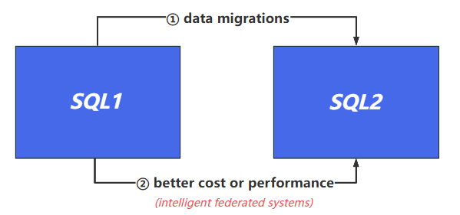
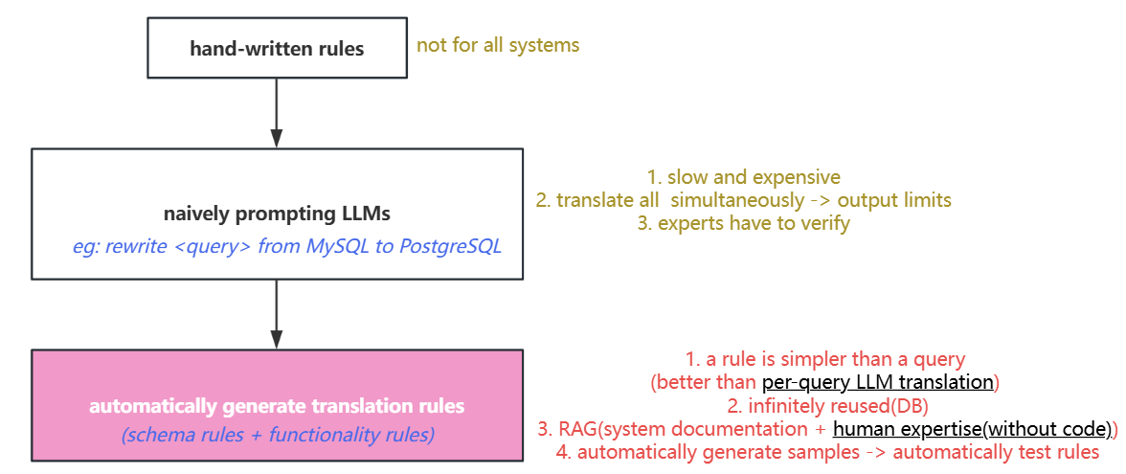
Introduction
solutions
problems

Slide 4
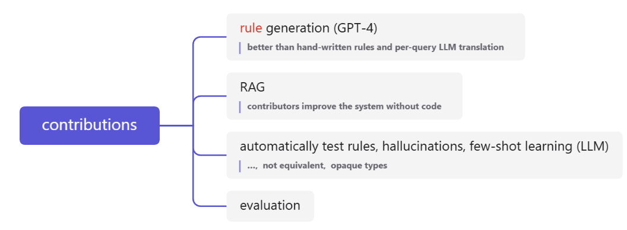
ChromaDB (high-dimensional vector)
+ OpenAI’s test-embedding-ada-002

Slide 5
Mallet

Slide 6

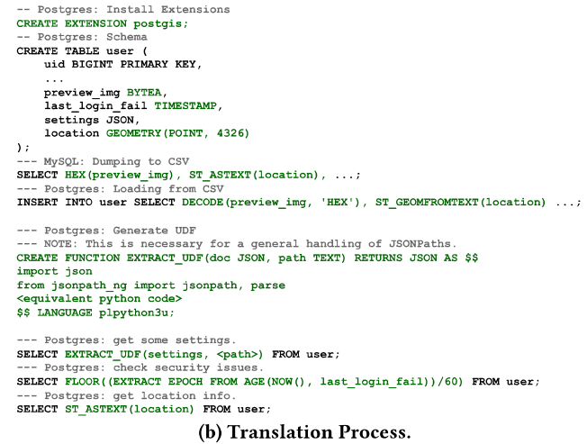
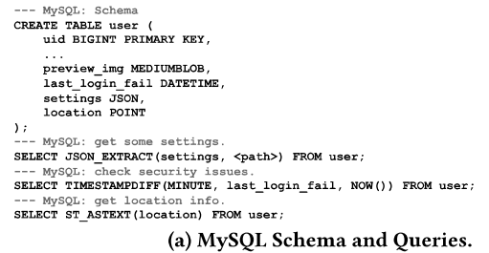
Example
JSONPath

Slide 7
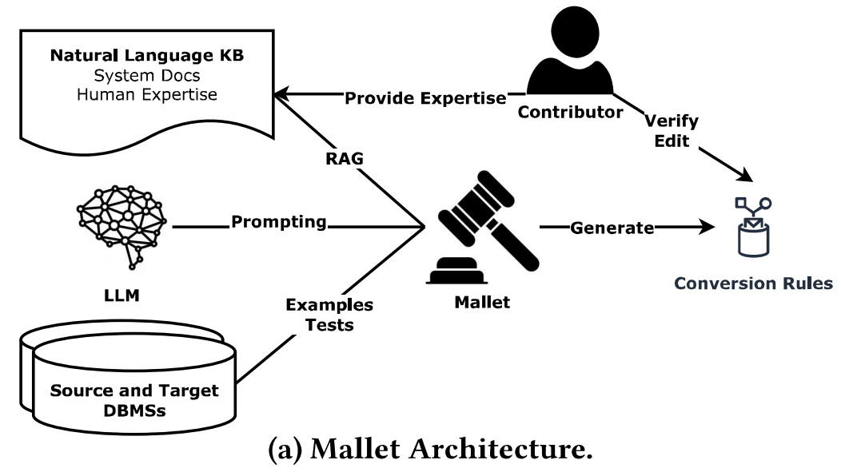
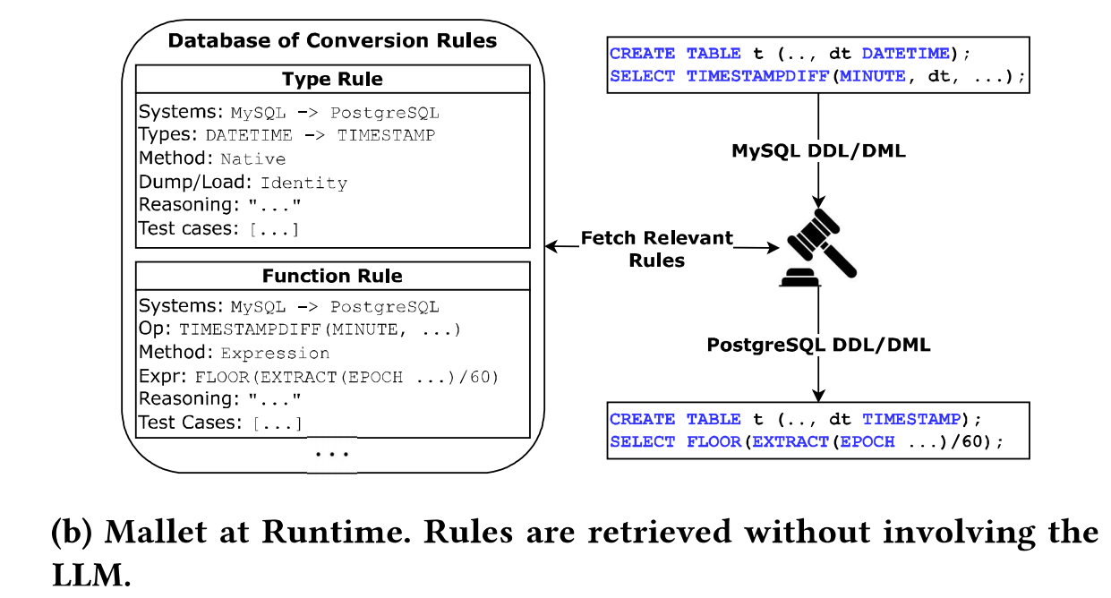
Overview

Slide 8
RAG
Using the DBMSs
System Documentation
Hallucination Detection
(1) rely on keywords to search
(2) use vector embedding similarity search
(1) LLM -> correct input/output -> if equivalent ?
(2) reprompt in 2 ways:
① include previous errors in prompts to fix
② make small twesks to incorrect rules
Contributor Expertise
(1) without code
(2) rely on exact search (within prompts)
(3) regex
Few-shot learning
opaque types (LLM)

Slide 9
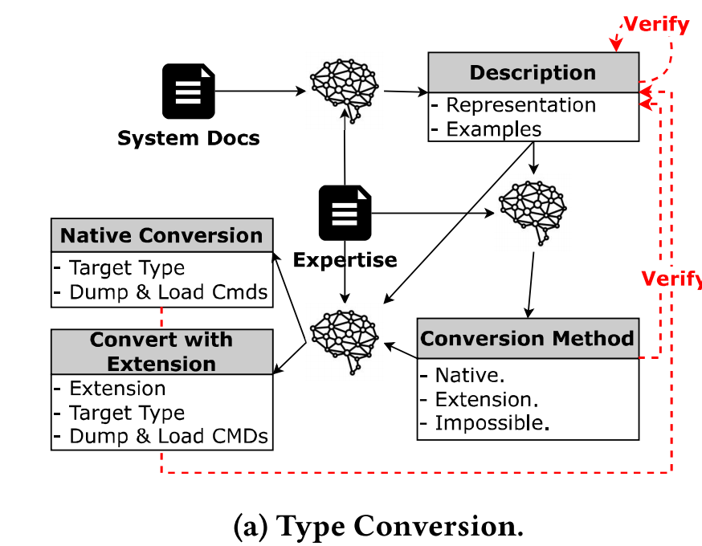
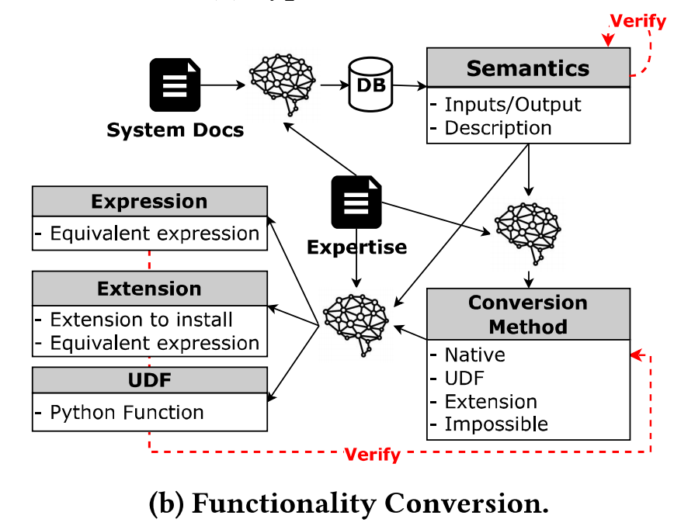
Conversion Rules
①
④
(corner cases)
②
⑤
(Python)
③
⑥
(solution: federation)

Slide 10
Evaluation

Slide 11
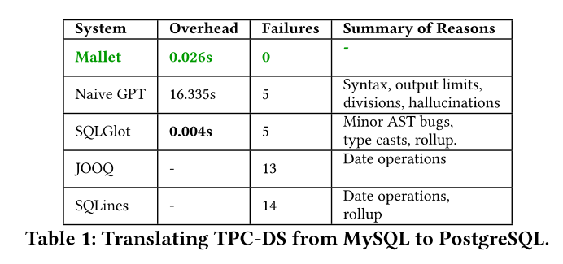
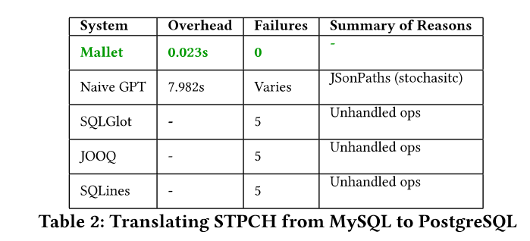
Evaluation
“We evaluate with 2 workloads, translating them from MySQL to PostgreSQL.”
use Python but faster
without Mallet
commercial migration tools
(1)contain few special functions
(2)enhanced performance over per-query translation
(1)adds more types(eg: JSON, binary, spatial), more special operations
(2)each system have its own STPC-H -> expand it

Slide 12
Future Directions

Slide 13
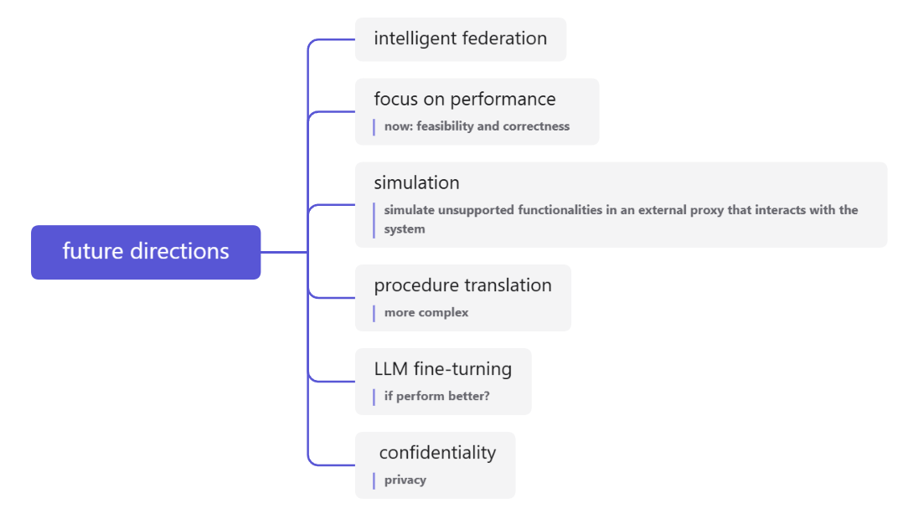

Slide 14
Comparison

Slide 15
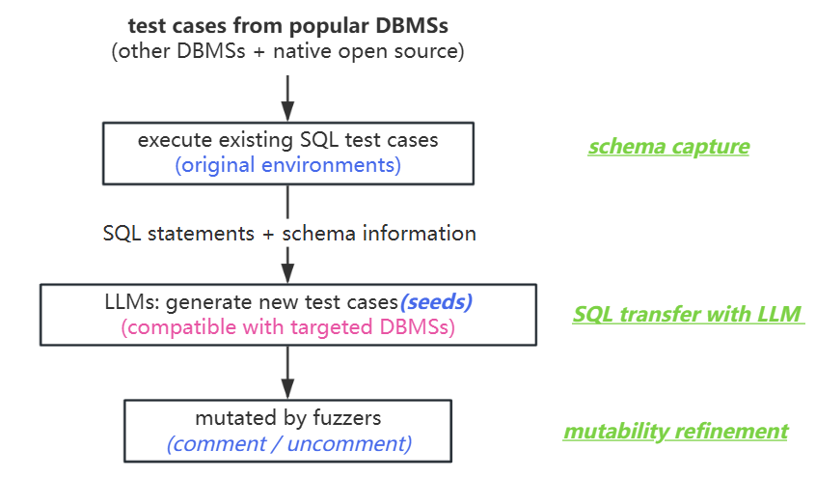
Tsinghua
MIT

Slide 16

Thank You

